Slide 1


Group 16
Nagib Shah (nsha9343)
Ling Qi (liqi6811)
Young Choi (ycho8487)
Xinan Ma (xima3772)
Predicting Novel Kinase-Substrates

Slide 2
AGENDA
Intro & Problem Statement
Initial Exploration
Feature Extraction & Selection
Model Analysis & Evaluation
Positive Unlabeled Learning – Let there be light
Final Predictions (Ensemble)
Benchmark, Evaluations & Simulation
Conclusion

Slide 3
INTRODUCTION & OBJECTIVE
DATASET The phosphoproteomics dataset contains 12062 obs. of phosphorylation sites and 17 variables (key properties)
Small subset (22) known AKT substrates
Small subset (26) known mTOR substrates
Key characteristics of dataset include – temporal profile of the insulin stimulated phosphorylation, amino acid sequence of each sites (sequence window), generic/specific inhibitor details to prevent AKT and mTORs from phosphorylating their substrates etc.
OBJECTIVE Apply classification techniques and methods to predict & identify novel AKT and mTOR substrates in the primary dataset by applying learning techniques utilising the small subsets. One of the primary objective of this exercise is to apply positive unlabeled learning.

Slide 4
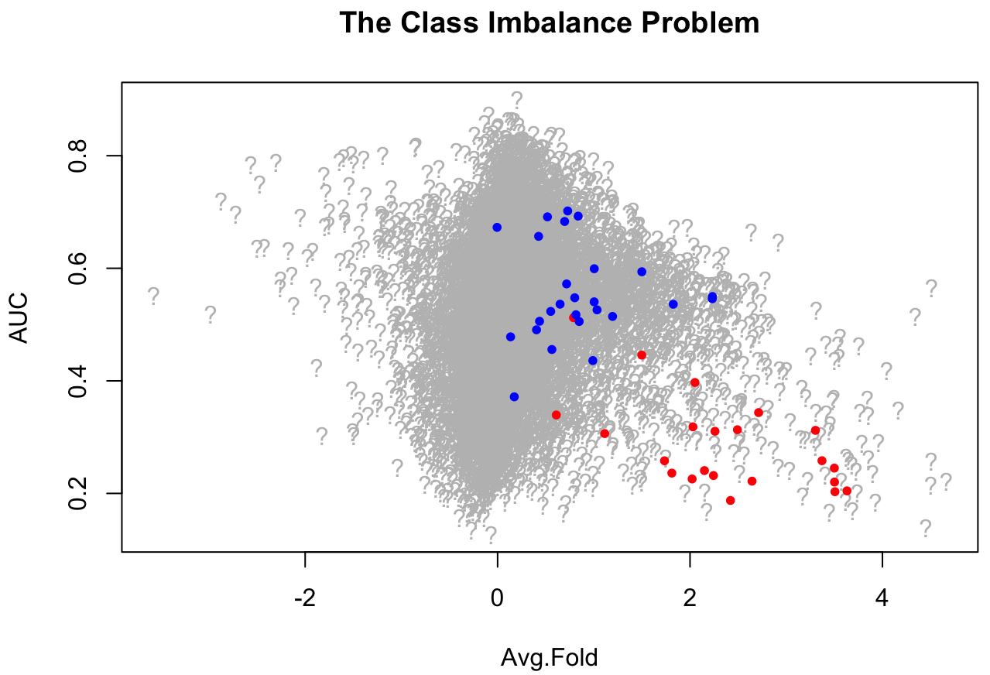
PROBLEM STATEMENT
A very small subset of labelled data (known AKTs and mTORs) to train model on
Majority class unknown
Class imbalance problem

Slide 5
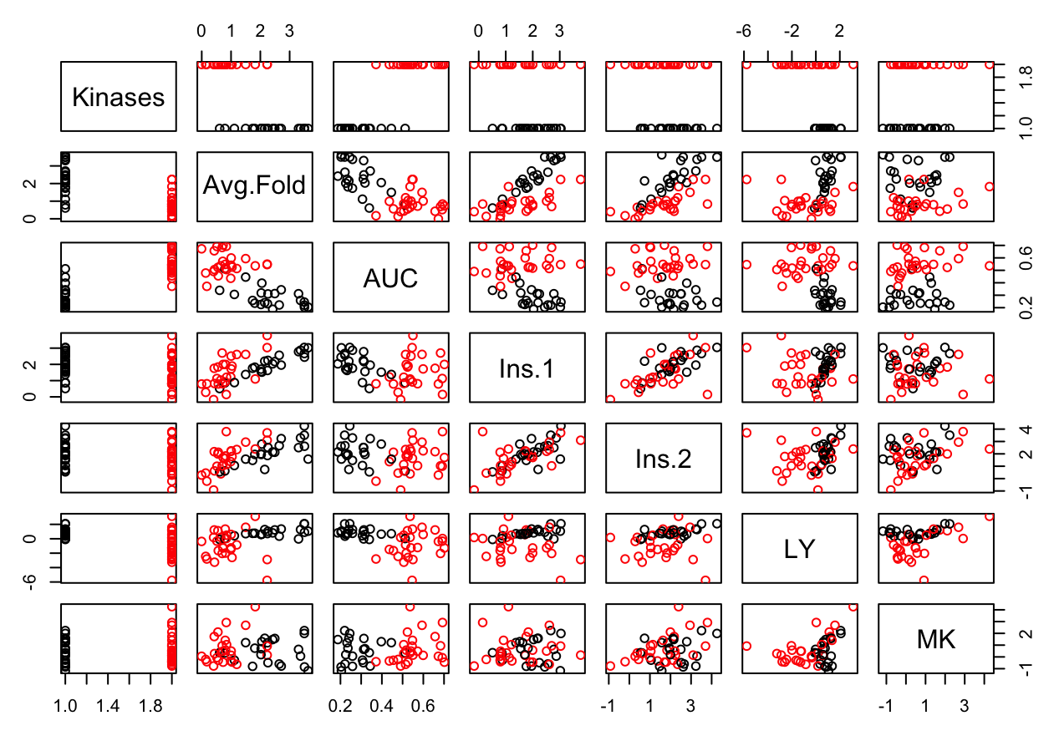
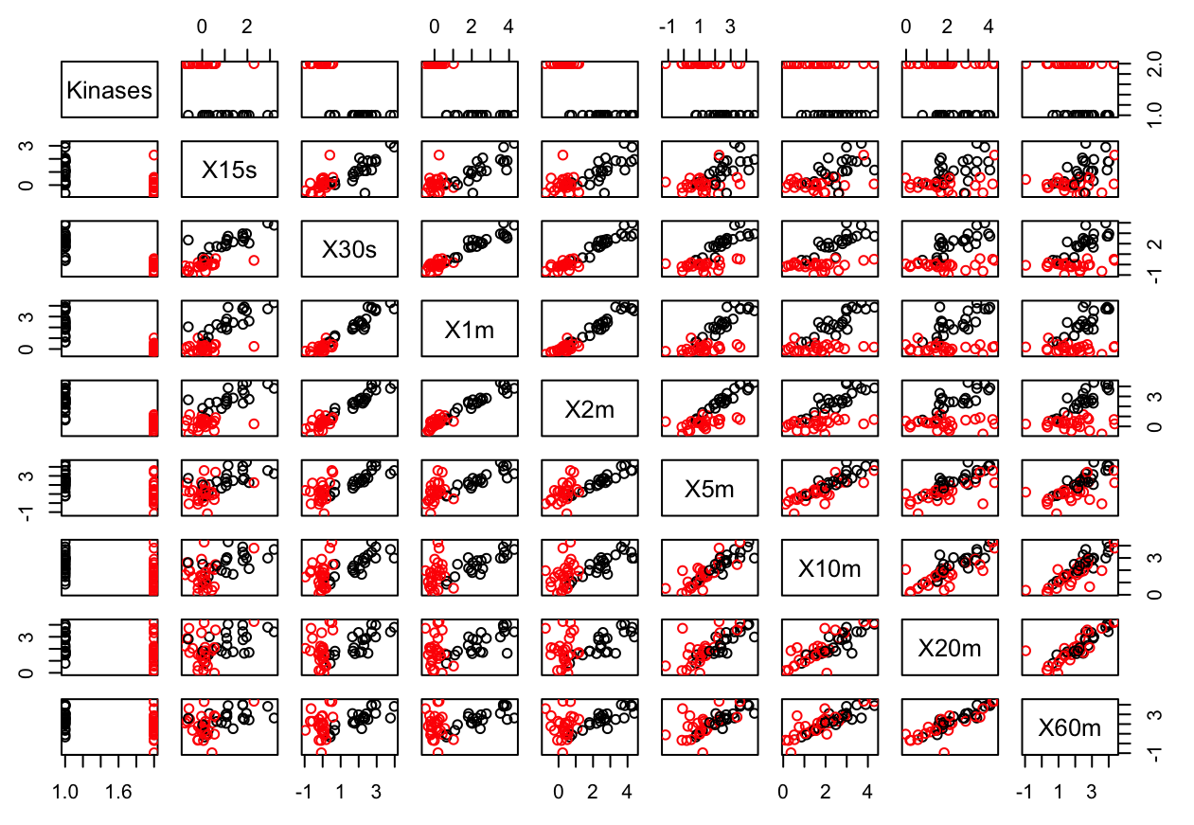
Initial Exploration (Visual)
Initial load and pairwise plot to see how the data is separated.
Most features allow the mTOR and AKT data to be separated visually.
Assumption made that SVM may be a good fit to separate the mTOR and AKT substrates
Pairwise plot of known AKT and mTOR substrates (mutually exclusive) Red points = mTOR
Black points = AKT

Slide 6
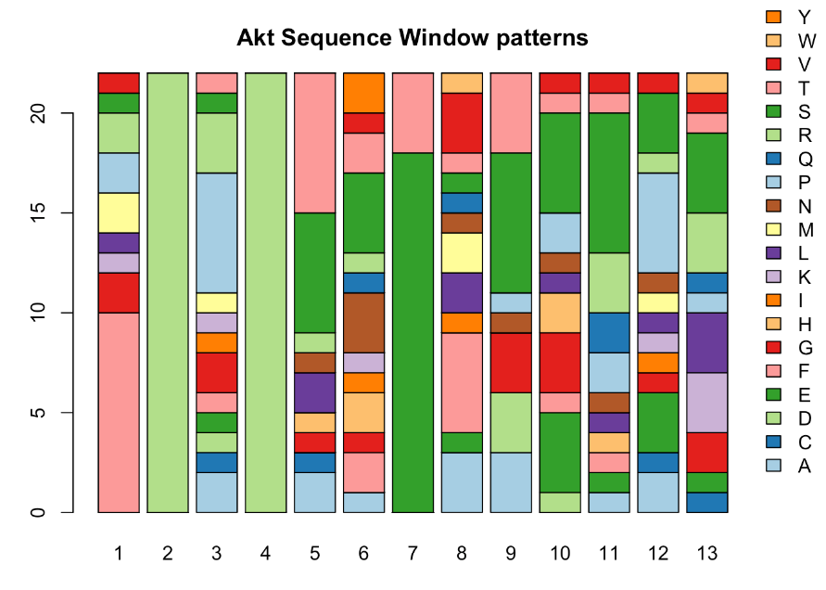
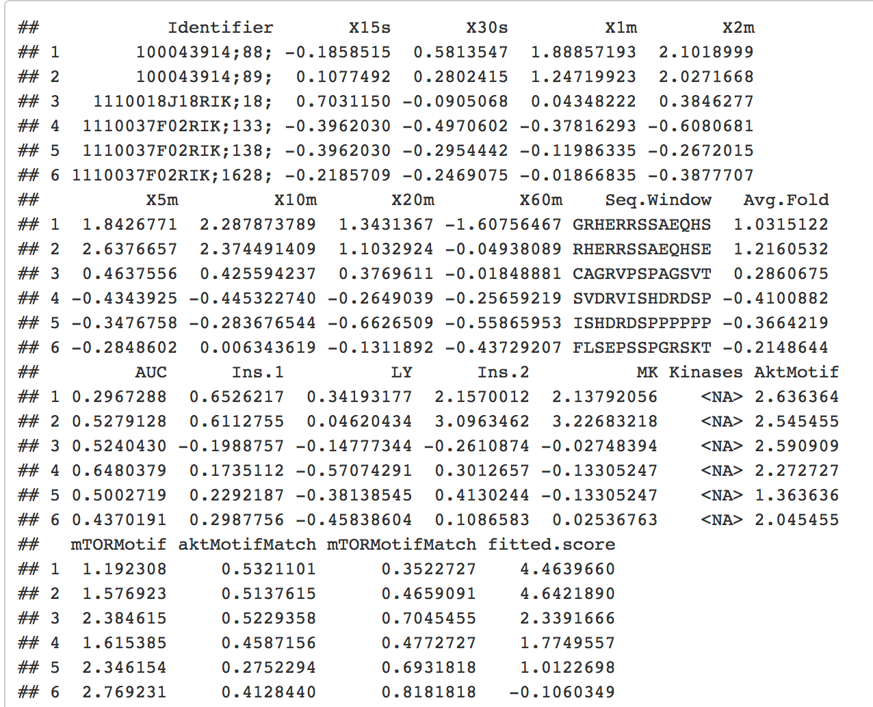
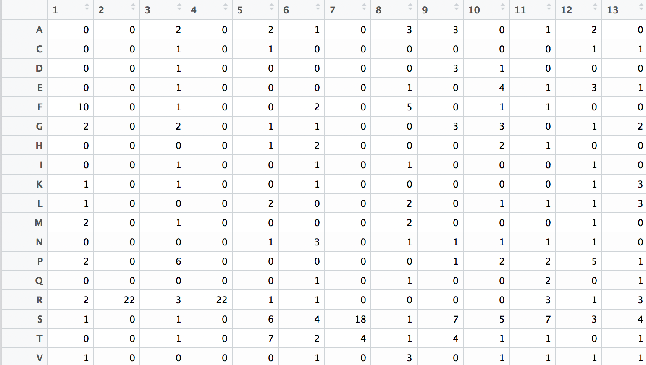
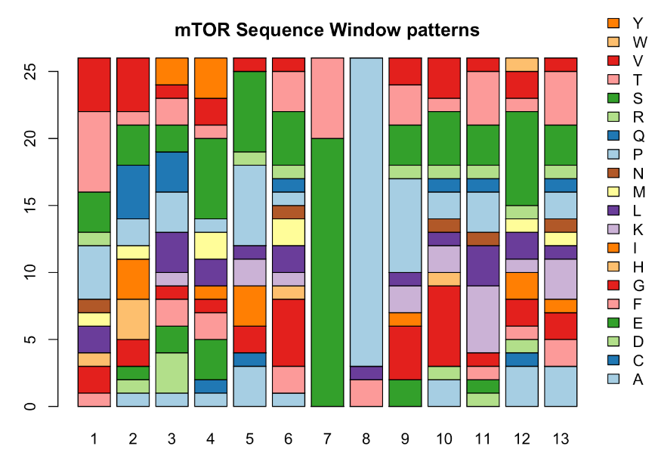
FEATURE EXTRACTION
4 new features created
AKT Motif (Extracted from Amino Acid sequence)
mTOR Motif (Extracted Amino Acid Sequence)
Temporal Profile Fit (to indicate the trend in the temporal data)
Avg Score
Motif was calculated utilising Position Specific Scoring System (PSSM) to calculate a % match

Slide 7
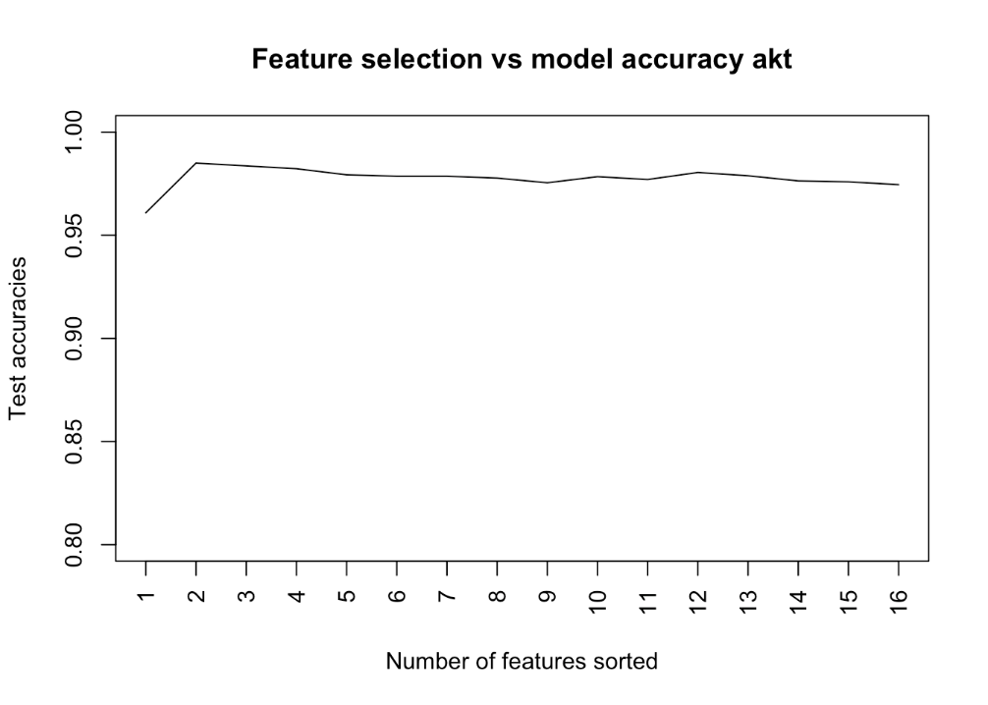
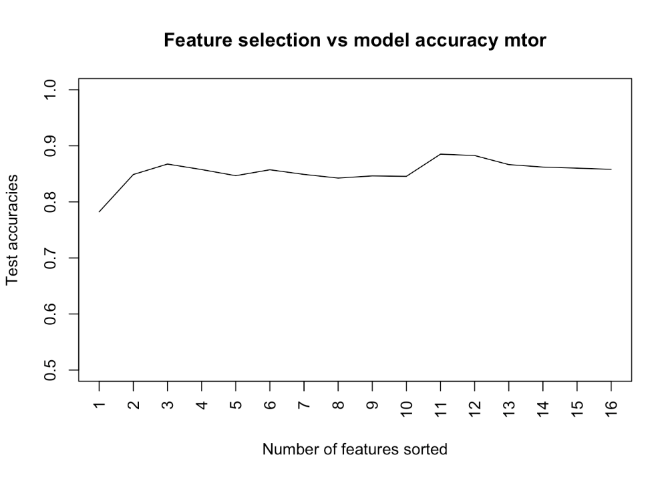
FEATURE SELECTION
Technique –
Ranking of features based on t-test
Apply a wrapper feature selection process using backward stepwise process
Random sampling of 100 iterations and validation utilising LOOCV was carried out to evaluate and assess the overall performance of the models.
Findings:
All 16 features are quite important and no significant drop in performance.
Therefore no features are dropped

Slide 8
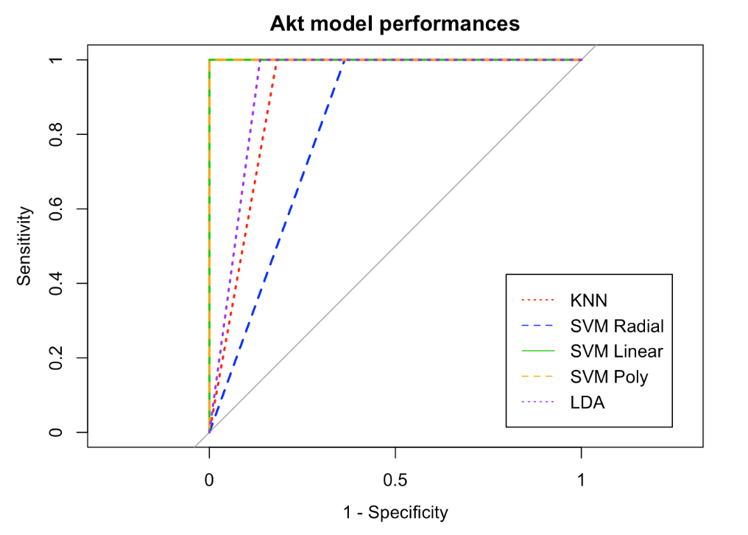
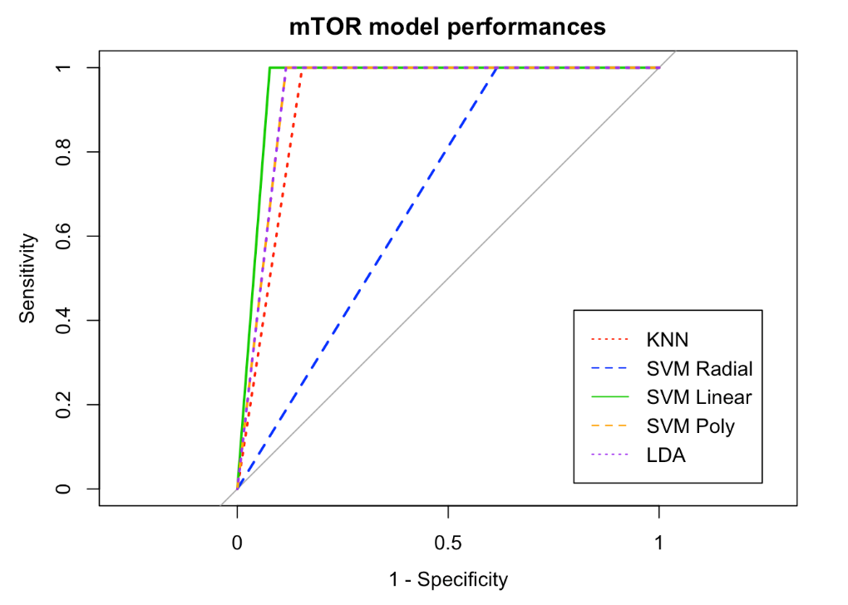
MODEL EVALUATIONS
Selection of KNN, SVM Radial, SVM Linear, SVM Polynomial and LDA were all evaluated to see how well these models separate the data.
Random sampling
LOOCV was carried out to evaluate the models
Predictions made on a newly sampled data (test)
Various model tuning parameters used to find the best tuning parameters that explain the separation.
RESULT:
SVM Radial
Tuning params: Sigma: 1 & Cost: 1.1

Slide 9
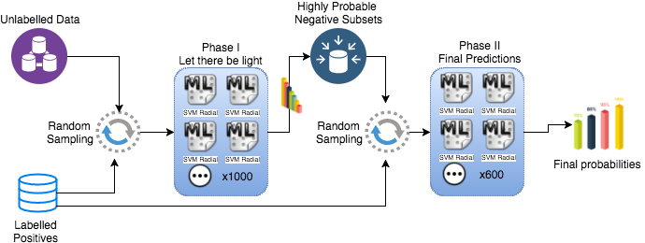
MODEL ARCHITECTURE

Slide 10
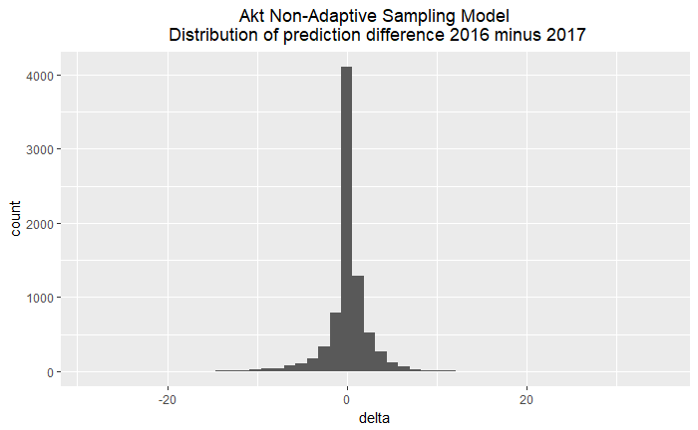
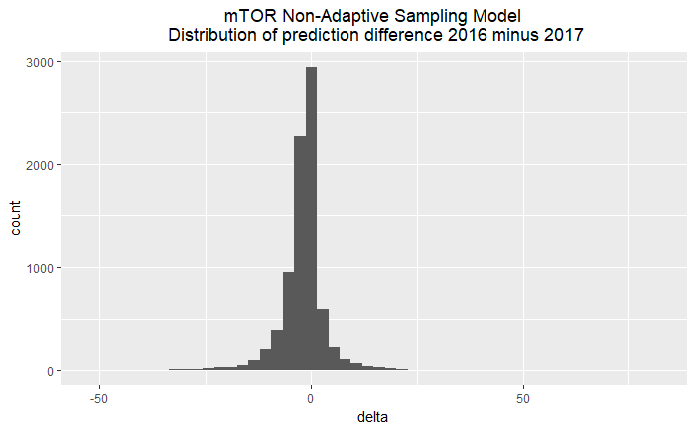
PHASE I: POSITIVE UNLABELLED LEARNING
Problems we need to solve are:
Class Imbalance
Semi-supervised learning
Adaptive sampling
Phase I result:
12k + unlabelled data
Randomly select 22
22 known Akt
- We built model.
- Predicted full data set.
- Saved the results.
- Iterated the sample process 1000 times (Bagging)
- Ensemble Average technique to calculate final probability percentage
Notes:
Ensemble process done to remove/reduce bias. Since know little about the distribution of the negative samples

Slide 11
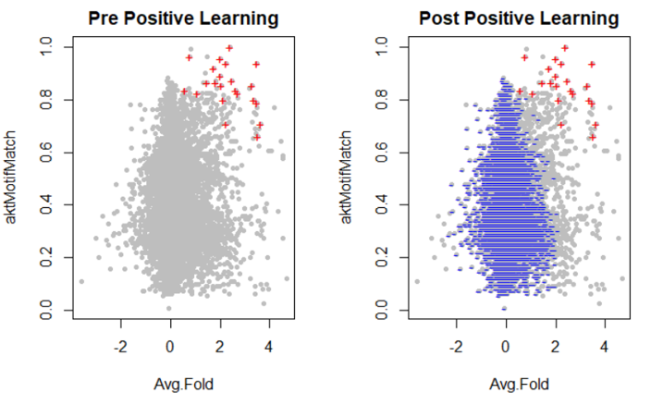
LET THERE BE LIGHT

Slide 12
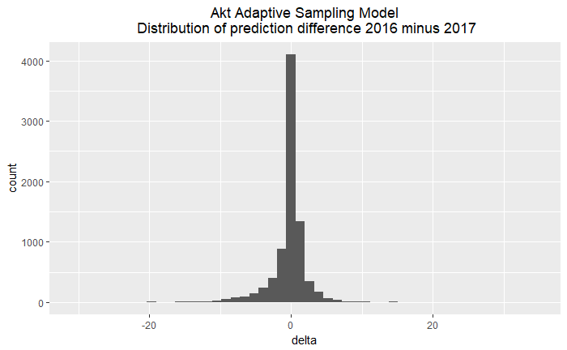

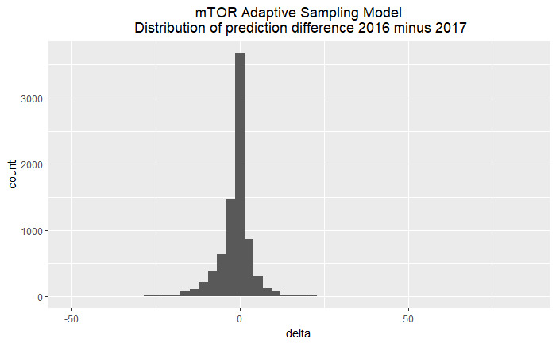
PHASE II: FINAL PREDICTIONS
Phase II result:
Akt probability value
40%
Negative subset
22 known Akt
Randomly select 22
We picked 22 from smaller highly probable negative subset generated from Phase I
Build model
Predict full data set
Save the result
Iterate the sample process 600 times.
Ensemble Average technique to calculate final probability percentage
mTOR negative subset threshold set up at 60%

Slide 13
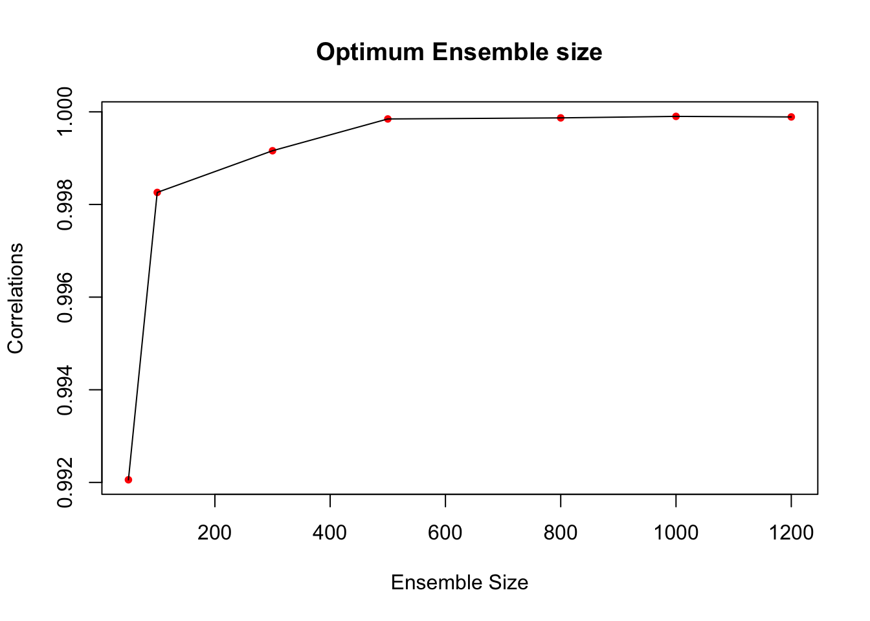
FINAL PREDICTIONS
Correlations vs Ensemble size
Find the best/optimum iteration size
Make final prediction using the convergence point.

Slide 14
BENCHMARKING & EVALUATION
This flow chart illustrates the process we undertook to benchmark 2016 versus 2017 prediction results

Slide 15
BENCHMARKING & EVALUATION
This flow chart illustrates the process we used to generate the simulation data set for benchmarking

Slide 16
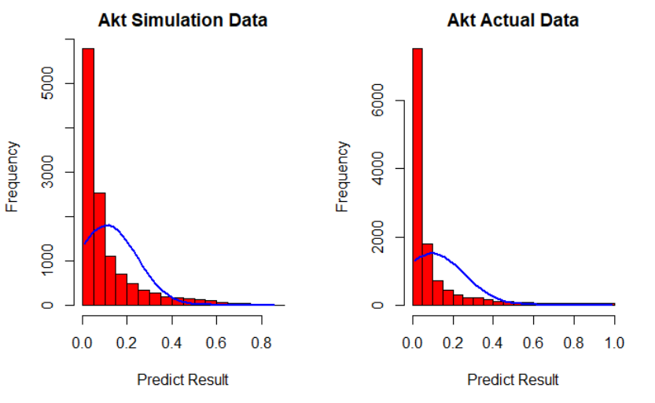
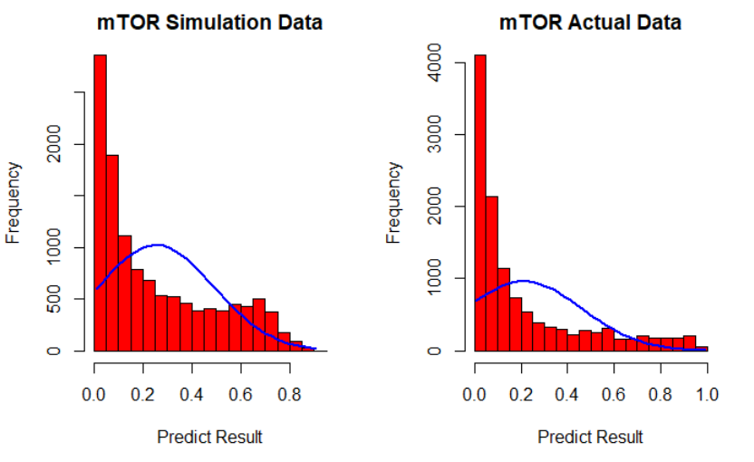
SIMULATION FOR BENCHMARKING
Our simulation result is following the same probability distribution as the actual data

Slide 17
CONCLUSION & FINAL THOUGHTS
Our Phase 1 prediction achieved a good result, especially for the Akt model (delta -5% to 5% with an approx. spread of -15% to 12%) however, mTOR prediction results indicate a larger spread -35% to 25% as compared to 2016 results.
From the phase 1 result, we set up a negative threshold to create a smaller/highly probable negative sub-set from the unlabelled data.
An additional ensemble process was carried out utilising the smaller negative subset to make the final predictions (Adaptive Sampling approach). This resulted in an improved result of the mTOR predictions (deltas -5% to 5% with a smaller spread).

Slide 18
CONTRIBUTIONS
Nagib Shah | Planning / Data Prep / Research / Model Evaluation & Validation / Feature Selection & Extraction / Positive UL Learning / Ensemble baseline / Presentation/ Code Cleanup/Refactor / QA
Ling Qi | Planning / Data Prep / Model Build / Research / / Positive UL Learning / Prediction Result (ensemble) + Baseline / Validation / Delta Analysis / Simulation / Presentation / Code Cleanup/Refactor / QA
Young Choi | Data Explorer/ Feature Analysis / Draft Presentation / QA / references
Xinan Ma | Data Explorer / Feature Analysis / Feature Extraction / QA / references

Slide 19

THANK YOU
Group 16 Signing off
Nagib Shah (nsha9343)
Ling Qi (liqi6811)
Young Choi (ycho8487)
Xinan Ma (xima3772)

